Slide 1

Bridging the Gap between Technical Savvy and Ease
How to create R graphics with automation processes to be shared with others

Slide 2


Wouldn’t it be nice if. . .
We could have the power of R
Married to the ease of Word?

Slide 3


Most of us have heard that. . .
There are multiple ways to incorporate desktop publishing into R
Most of us have found that. . .
It takes a lot more effort than using industry standard software

Slide 4
A little background on publishing with R
Importantly, analysts publish on R all the time
We have LaTeX typesetting for mathematical formulas and more
We have multiple versions of markup languages, including R Markdown and CSS, which can be used in variously in R
Given the open-source nature of R, we also have countless packages created for specific instances of direct desktop publishing through R

Slide 5

Information Architecture User Experience
WYSIWYM
What You See is What you Mean
WYSIWYG
What You See is What You Get
Drag-and-Drop and Interactive Controls
Notes:
For most offices however, the reality is that we have staff with a wide variety of skill sets and patience in learning new tools, especially tools that they may never have the opportunity to use with outside of work.

Slide 7
Today’s Demonstration
Step 1: Create a design template for your final product in MS Word
Step 2: Create images in R with a naming convention for links
Step 3: Create a data table in R with the names of images
Step 4: Create merged documents in MS Word
Step 5: Print and distribute as usual

Slide 8
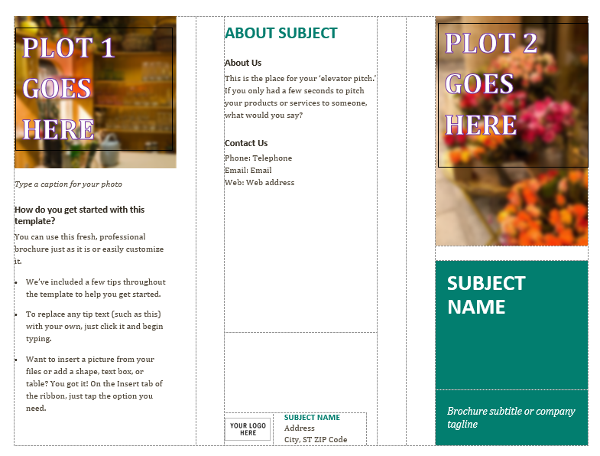
Create a template in Word using table cells of specific size
These cells will be populated with high quality graphics sized in R

Slide 9
In R, use the following script to produce print quality graphics of specific size
library(tidyverse)
plot2 <- ggplot(foo, bar)
ggsave(paste0 (data$baz, "_plot2.png"), device = "png",
width=4.02,
height=2.67,
dpi=600)
Save plot as object and add data specific to your document for Word to merge to

Slide 10
In R, create a merge table for Word merge
For each document desired, create a record (row). Be sure to name your fields in conjunction with your saved images
AREA | ST | STATE | OCC_CODE | OCC_TITLE | plot1 | plot2
15 | HI | Hawaii | 13-1121 | Meeting, Convention, and Event Planners | 13-1121_plot1.png | 13-1121_plot2.png
15 | HI | Hawaii | 17-2051 | Civil Engineers | 17-2051_plot1.png | 17-2051_plot2.png
15 | HI | Hawaii | 29-1141 | Registered Nurses | 29-1141_plot1.png | 29-1141_plot2.png
15 | HI | Hawaii | 53-6021 | Parking Lot Attendants | 53-6021_plot1.png | 53-6021_plot2.png

Slide 11
In Word, link images to your database as you would text fields
Create a merge document in Word
For image fields, use the following syntax. Press Alt-F9 to see the field. Include quote marks and full path.
Be sure to update before printing, using Ctrl-A (select all) and F9.
{INCLUDEPICTURE "{MERGEFIELD PictureLocation}" \d}
{INCLUDEPICTURE “c:\\data\\{MERGEFIELD plot1}” }

Slide 12

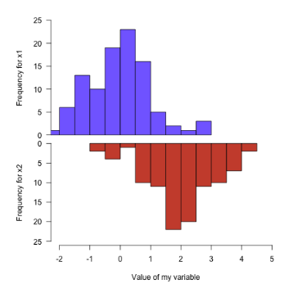
That’s it!
Print, share and update your R charts with ease
Honolulu Data Science Group Meetup – Oct 18, 2018
Presenter: Charlotte Yee, Hawaii Dept. of Education
808 733-4100 | charlotte.yee@notes.k12.hi.us
A big MAHALO to Sultan Ventures and XLR8HI for their continued support

